Slide 1


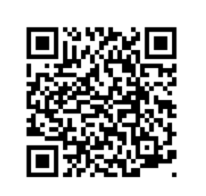
Questionnaire for first term students 2024/2025
Bachelor English
No QR-Scanner? find the access here:
www.th-rosenheim.de/erstsemesterbefragung
Access code: servus
Thanks!

